Slide 1



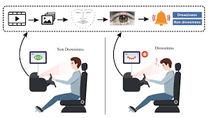
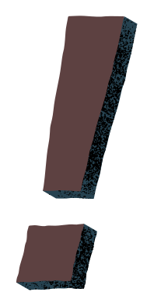

Drowsiness Detection
and Accident Prevention System
BATCH NO- 2
Struggles of the Every Day

Slide 2


LESSON OUTLINE
REAL-TIME DROWSINESS DETECTION
INSTANT ALERT SYSTEM FOR DRIVER
EMERGENCY ALARM FOR UNRESPONSIVE DRIVERS
INTEGRATION OF HARDWARE AND SOFTWARE
ACCIDENT PREVENTION

Slide 3

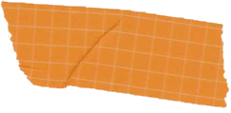

INTRODUCTION
1
2
3
Road accidents
due to driver drowsiness are a major cause of fatalities worldwide
Drivers often fail to realize their fatigue, leading to delayed reactions and dangerous situations.
This project aims to detect drowsiness in real time and prevent accidents through early alerts.

Slide 4


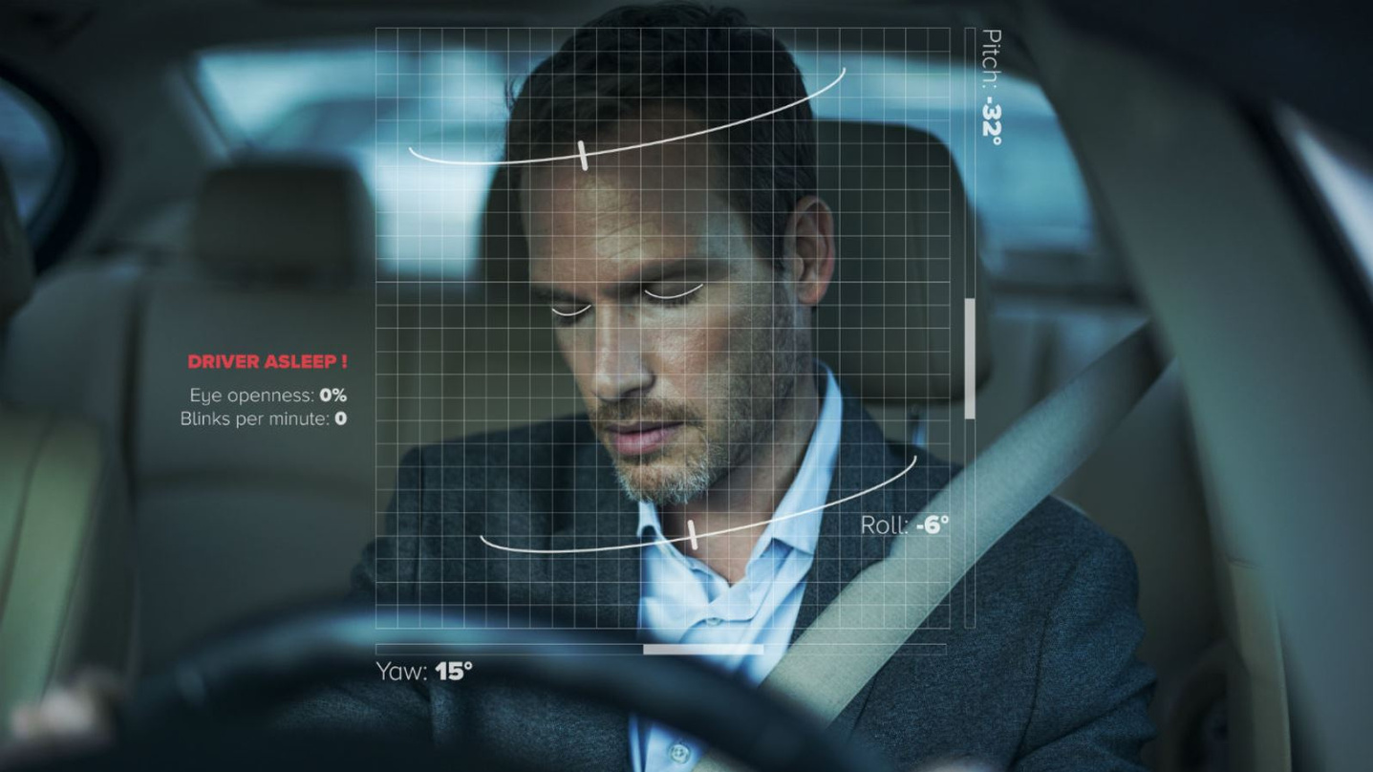
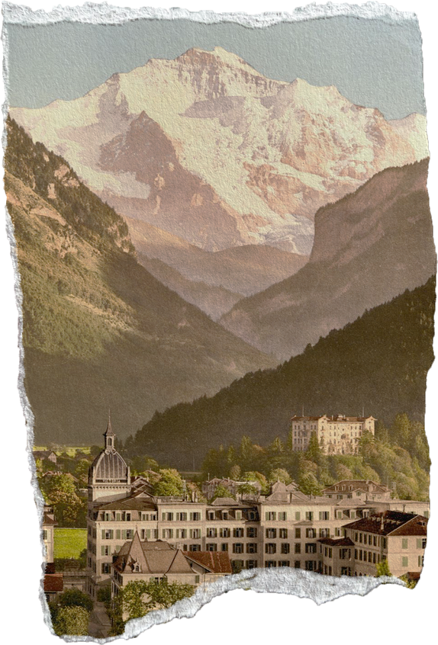


OBJECTIVES
To develop a system that detects driver drowsiness using computer vision.
To activate alerts (buzzer/voice) to wake up the driver.
It provides realtime alerts like phone call, message and email to closed ones during fatigue

Slide 5


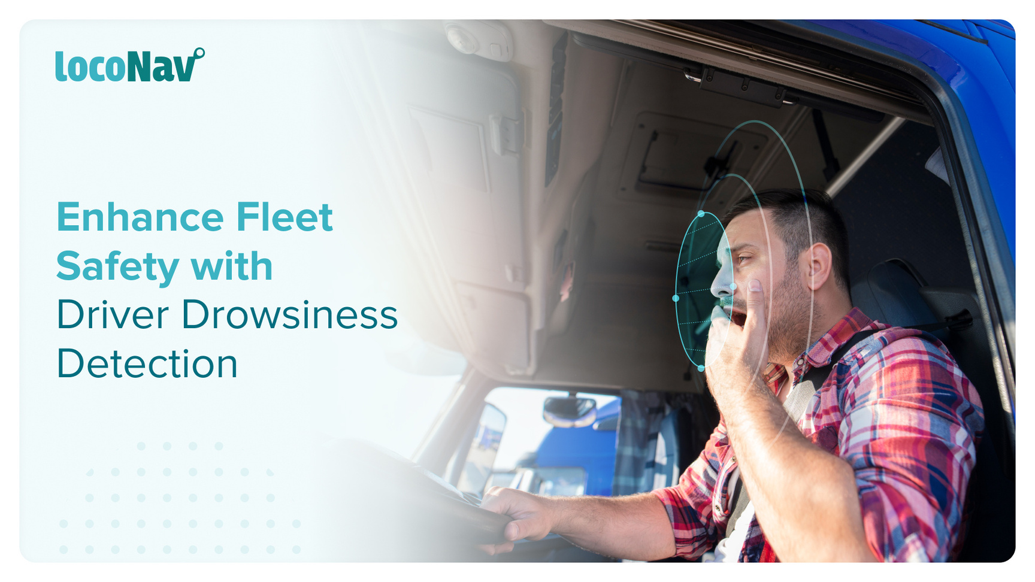
ABSTRACT
This project uses OpenCV and Python to track eye movements.
It analyzes eye closure duration to detect signs of drowsiness.
When the system detects prolonged eye closure or abnormal head movement, it triggers an alert system (buzzer or voice).
If the driver remains unresponsive, a louder emergency alarm is activated.
It intimates to hospital and closed ones

Slide 6


REQUIREMENTS
SOFTWARES
HARDWARES
PYTHON
OpenCV
Dlib
WEBCAM
Buzzer or speaker
power supply

Slide 7



METHODOLOGY
Face and Eye detection:
Using OpenCV and Dlib to detect facial landmarks.
Eye Aspect Ratio (EAR):
Measures eye closure duration.
Head Pose Detection:
Identifies if the driver’s head is tilting or drooping.
Alert system:
SHORT EYE CLOSURE
→ buzzer/voice alert.
LONG UNRESPONSIVENES
→ emergency alarms

Slide 8
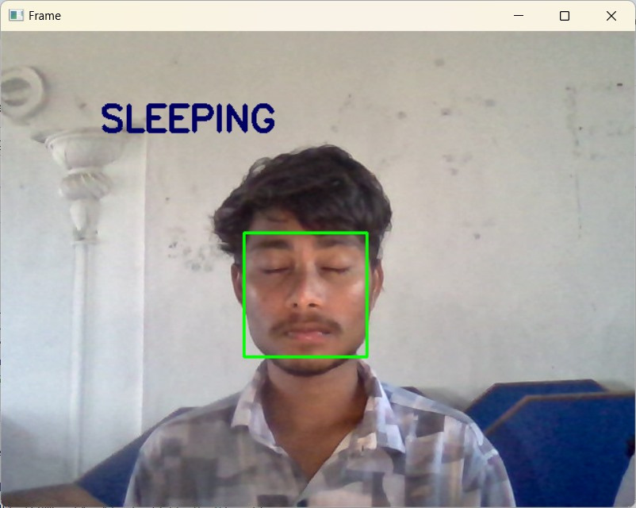
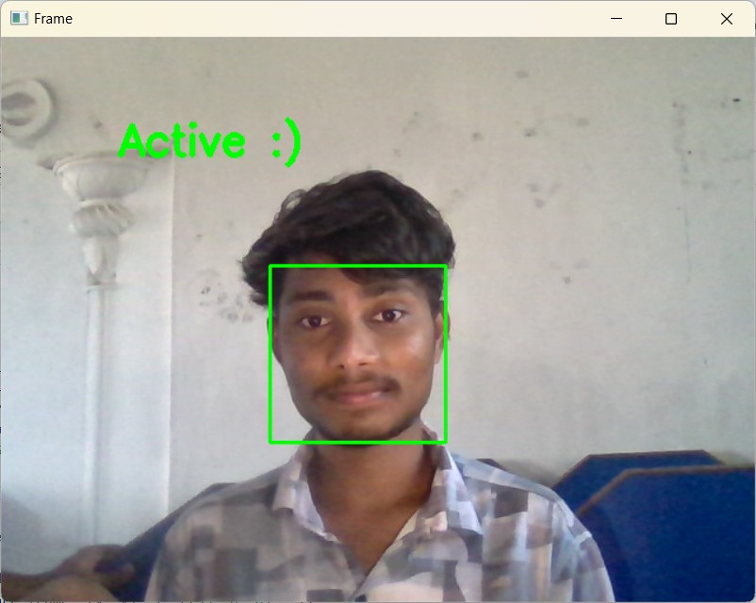
OUTPUT

Slide 9
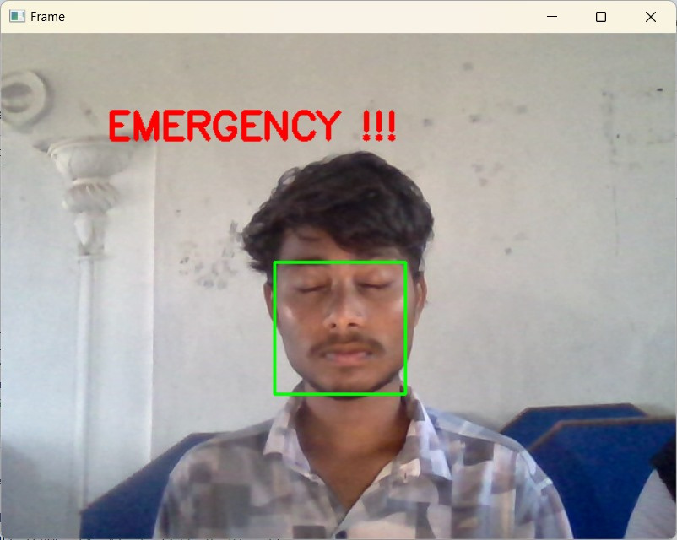

Slide 10


CONCLUSION
The system is affordable and can be implemented in both personal and commercial vehicles.
It enhances driver awareness and reduces the risk of human error.
With further development, it can be integrated with vehicle control systems for automatic emergency responses.

Slide 11


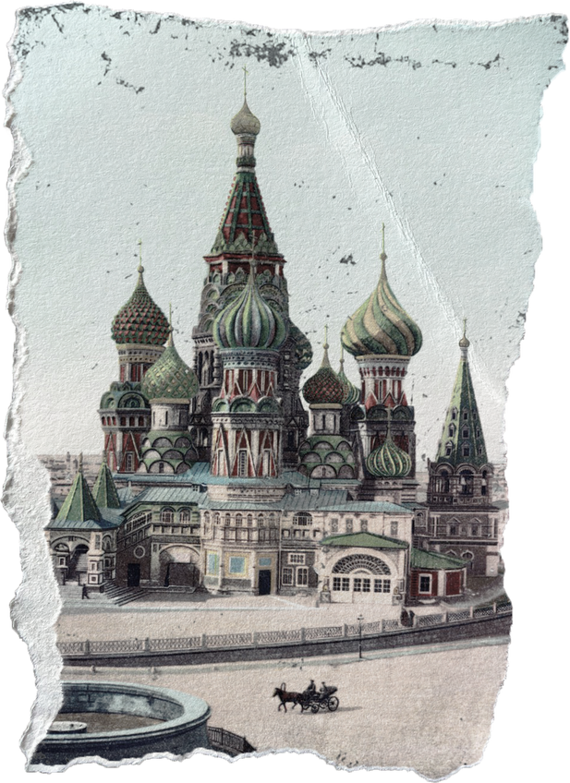

THANKYOU
Questions and Suggestions
WELCOME !

Slide 12







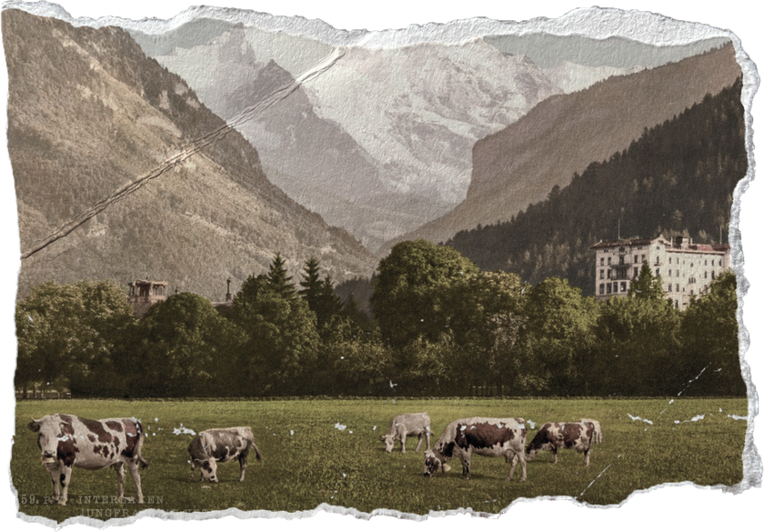
PRESENTED BY
G.LALITHA
K.DURGA PRASAD
B.AMULYA SINDHU
R.BHAVANI CHANDAN
RO200001
RO200519
RO200251
RO200564

